Slide 1
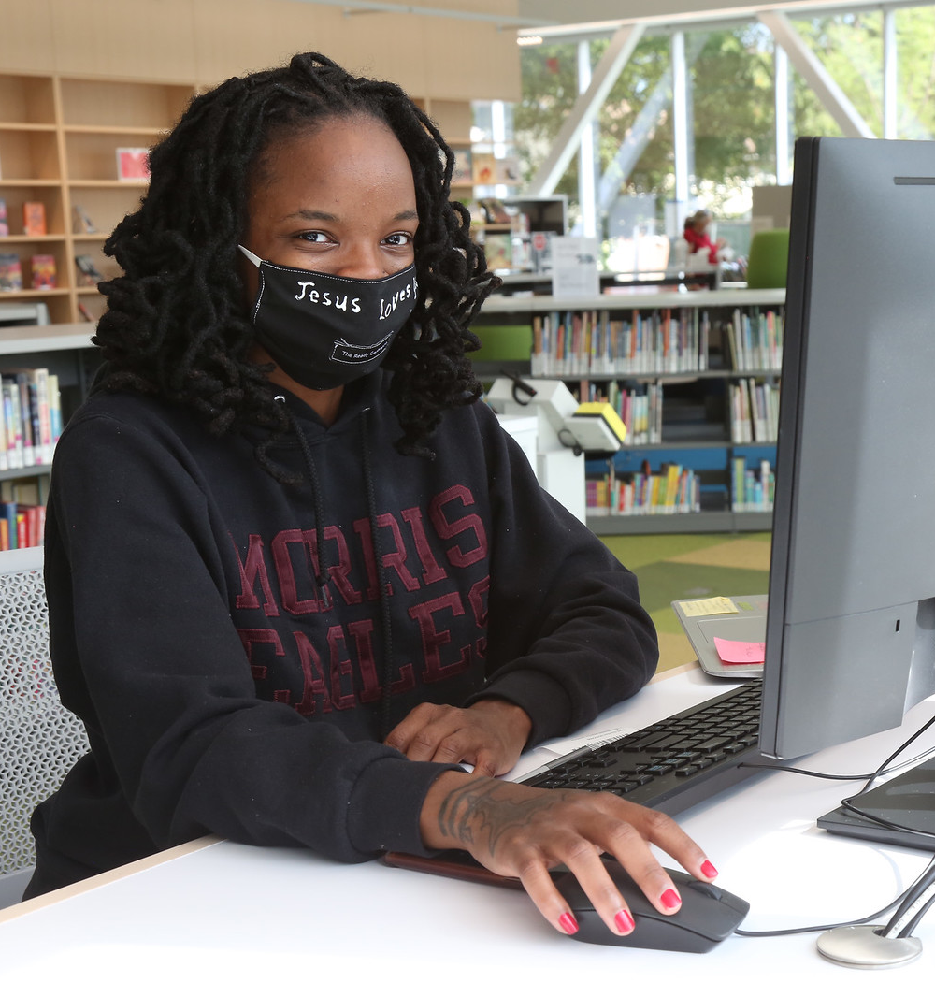
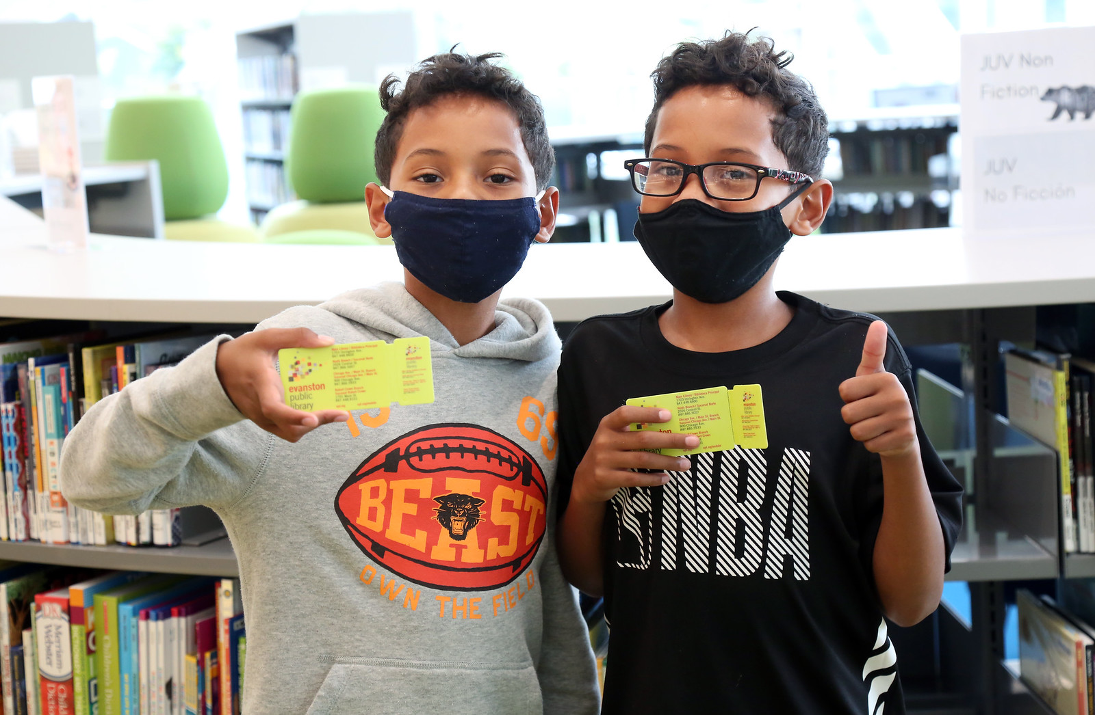

EVANSTON PUBLIC LIBRARY
2022 Budget Request
Karen Danczak Lyons
Executive Director
September 8, 2021

Slide 2
AGENDA
  2022 Baseline Budget Request
  2022 Adjusted Budget Request
  2022 Capital Budget Request
  Budget Process Next Steps
2022 Budget Request

Slide 3
2022 FUNDS OVERVIEW
Option 1
Funds | 2019 | 2020 | 2021 | 2022 | Change
Operating (Personnel) | 5,161,176 | 5,831,013 | 5,910,018 | 6,157.930 | 4.25%
Operating (Non Personnel) | 2,610,769 | 2,641,765 | 2,421,726 | 2,497,920 | 2.88%
Debt Service | 353,437 | 480,144 | 482,243 | 506,625 | 5.08%
Capital | 1,835,000 | 543,000 | 449,000 | 480,000 | 5.71%
TOTAL | 9,960,382 | 9,495,922 | 9,262,987 | 9,642.475 | 4.00%
2022 Budget Request

Slide 4
2022 FUNDS OVERVIEW
Option 2
Funds | 2019 | 2020 | 2021 | 2022 | Change
Operating (Personnel) | 5,161,176 | 5,831,013 | 5,910,018 | 6,081,975 | 2.95%
Operating (Non Personnel) | 2,610,769 | 2,641,765 | 2,421,726 | 2,497,920 | 2.88%
Debt Service | 353,437 | 480,144 | 482,243 | 506,625 | 5.08%
Capital | 1,835,000 | 543,000 | 449,000 | 480,000 | 5.71%
TOTAL | 9,960,382 | 9,495,922 | 9,262,987 | 9,566,520 | 3.20%
2022 Budget Request

Slide 5

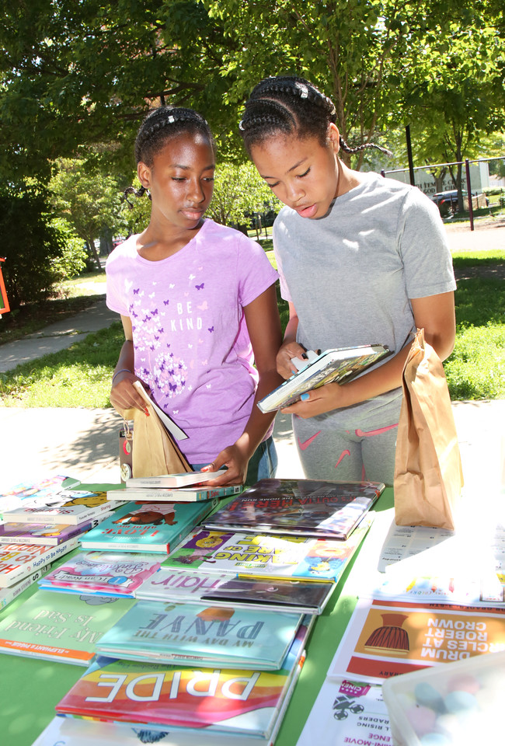
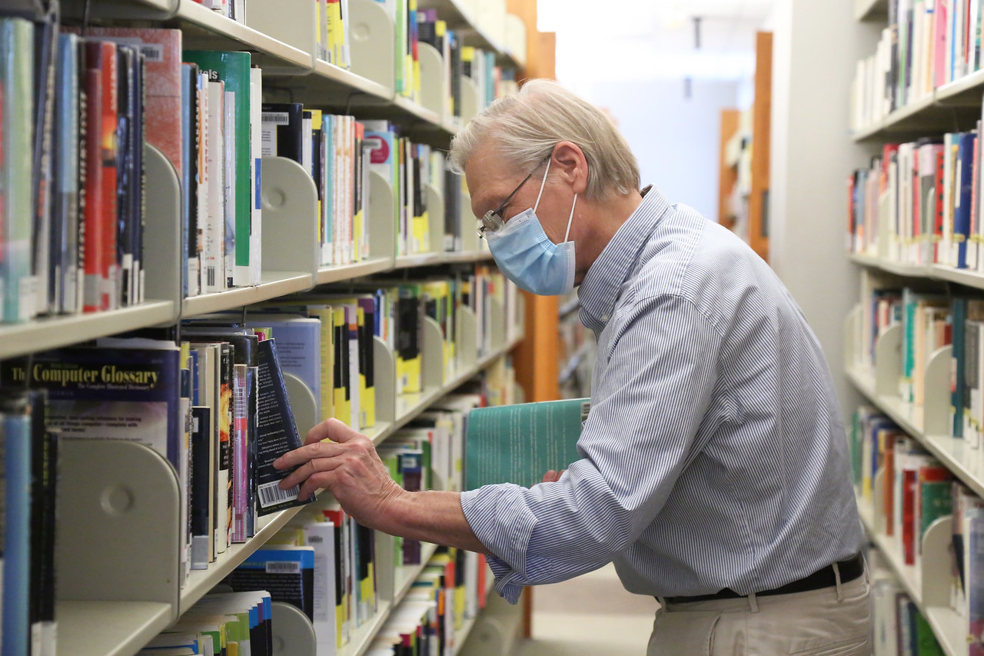
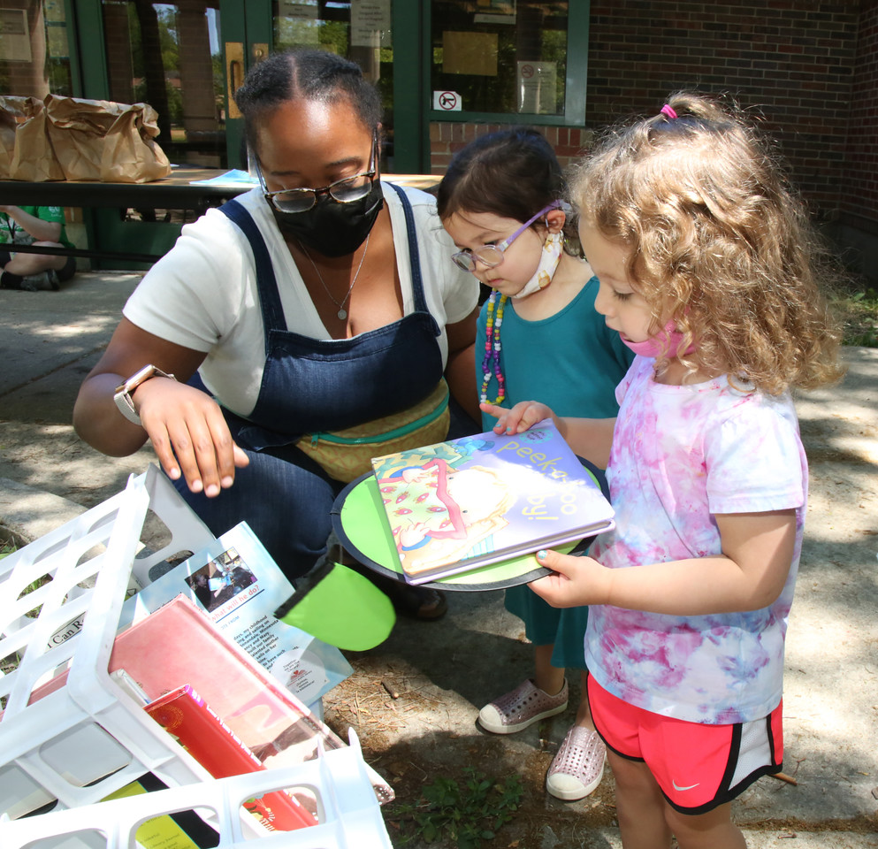
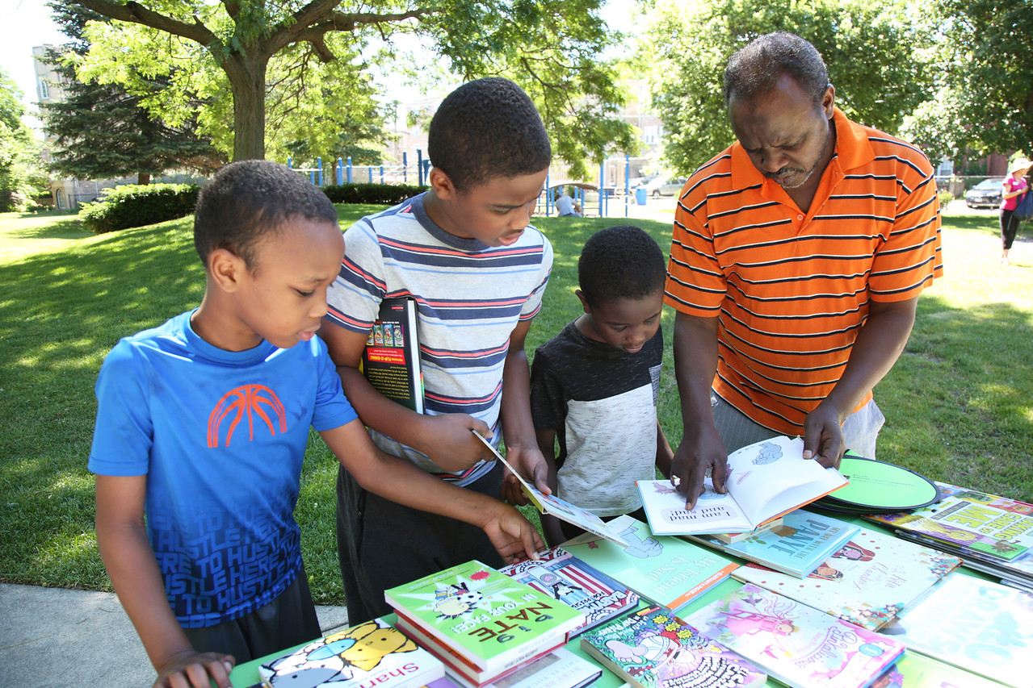
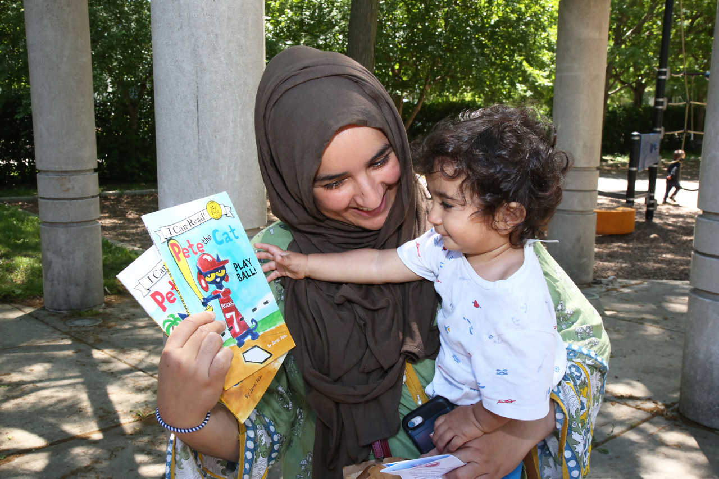
EPL SERVICES
The pandemic reinforced that EPL is more than a building of books - it is part of a social safety net that keeps our residents connected and informed.
2020 Highlights include reimagining services as we pivoted to virtual and outdoor programs, curbside pickup and shared technology in the midst of upheaval.
2022 Budget Request

Slide 6
2020 OUTPUT MEASURES
3,349 new library cards issued in 2020 (including 1865 e-cards)
914 virtual programs for all ages
1,289 total programs for all ages
Virtual program attendance: 13,200
Total program attendance: 21,220
YouTube Channel Views: 61,333
More than 60 new Early Literacy programs created for on demand viewing
243,630 digital items circulated (up 55% from 2019)
733,309 physical and digital materials circulated
300 appointments for one-on-one tech support sessions
155 Technology classes
Currently 36,973 registered borrowers with active cards
2022 Budget Request

Slide 7
OPERATING BUDGET (Fund 185)
 | 2019 | 2020 | 2021 | 2022
Personnel | 5,254,036 | 5,807,311 | 5,910,018 | 6,157.930
Non Personnel | 2,576,769 | 2,662,430 | 2,421,726 | 2,497,920
Total | 7,830,805 | 8,469,741 | 8,331,744 | 8,655.850
2022 Budget Request

Slide 8
Budget trends - expenses
Annual Operating Budget Expenditures
2022 Budget Request

Slide 9
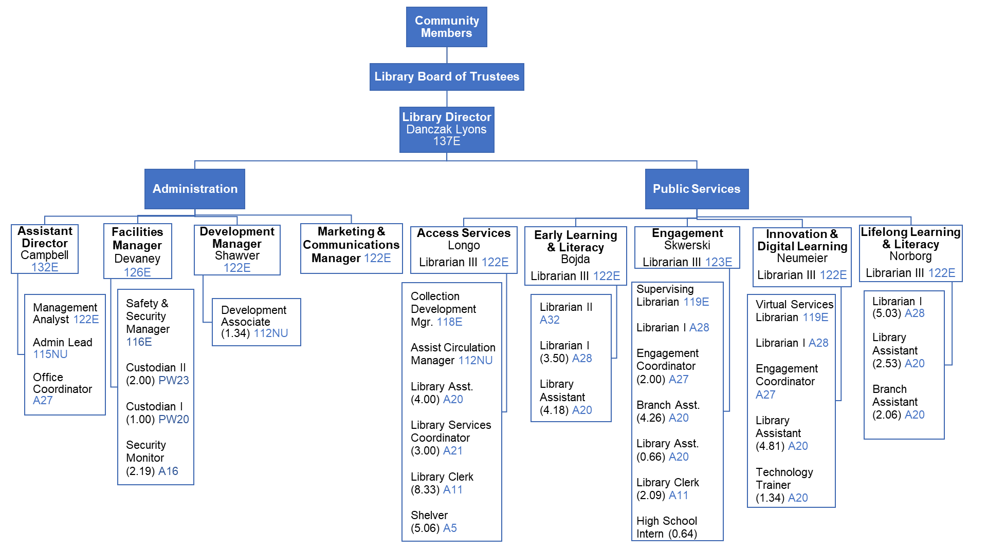
organization chart
2022 Budget Request

Slide 10
Staffing trends
Full Time Equivalents by Business Unit
2022 Budget Request

Slide 11
Staffing trends
Staffing by Business Unit
FY2021: 78.03 FTE FY2022: 79.39 FTE
2022 Budget Request

Slide 12
Wage increases
AFSCME (American Federation of State, County and Municipal Employees)
General Wage Increases or Longevity pay, and Cost of Living Adjustment
COLA | 2017 | 2018 | 2019 | 2020 | 2021 | 2022
Union | 2.75 % | 3 % | 0 | 1.5 % | 2.5 % | 3 %
Non Union | 0 | 5.75 % | 0 | 1.5 % | 0.75 % | 2.25 %
2022 Budget Request

Slide 13
PROposed ADJUSTMENT Budget
Any adjustments will be driven by the course of action outlined in new Strategic Plan (expected completion early 2022)
2022 Budget Request

Slide 14
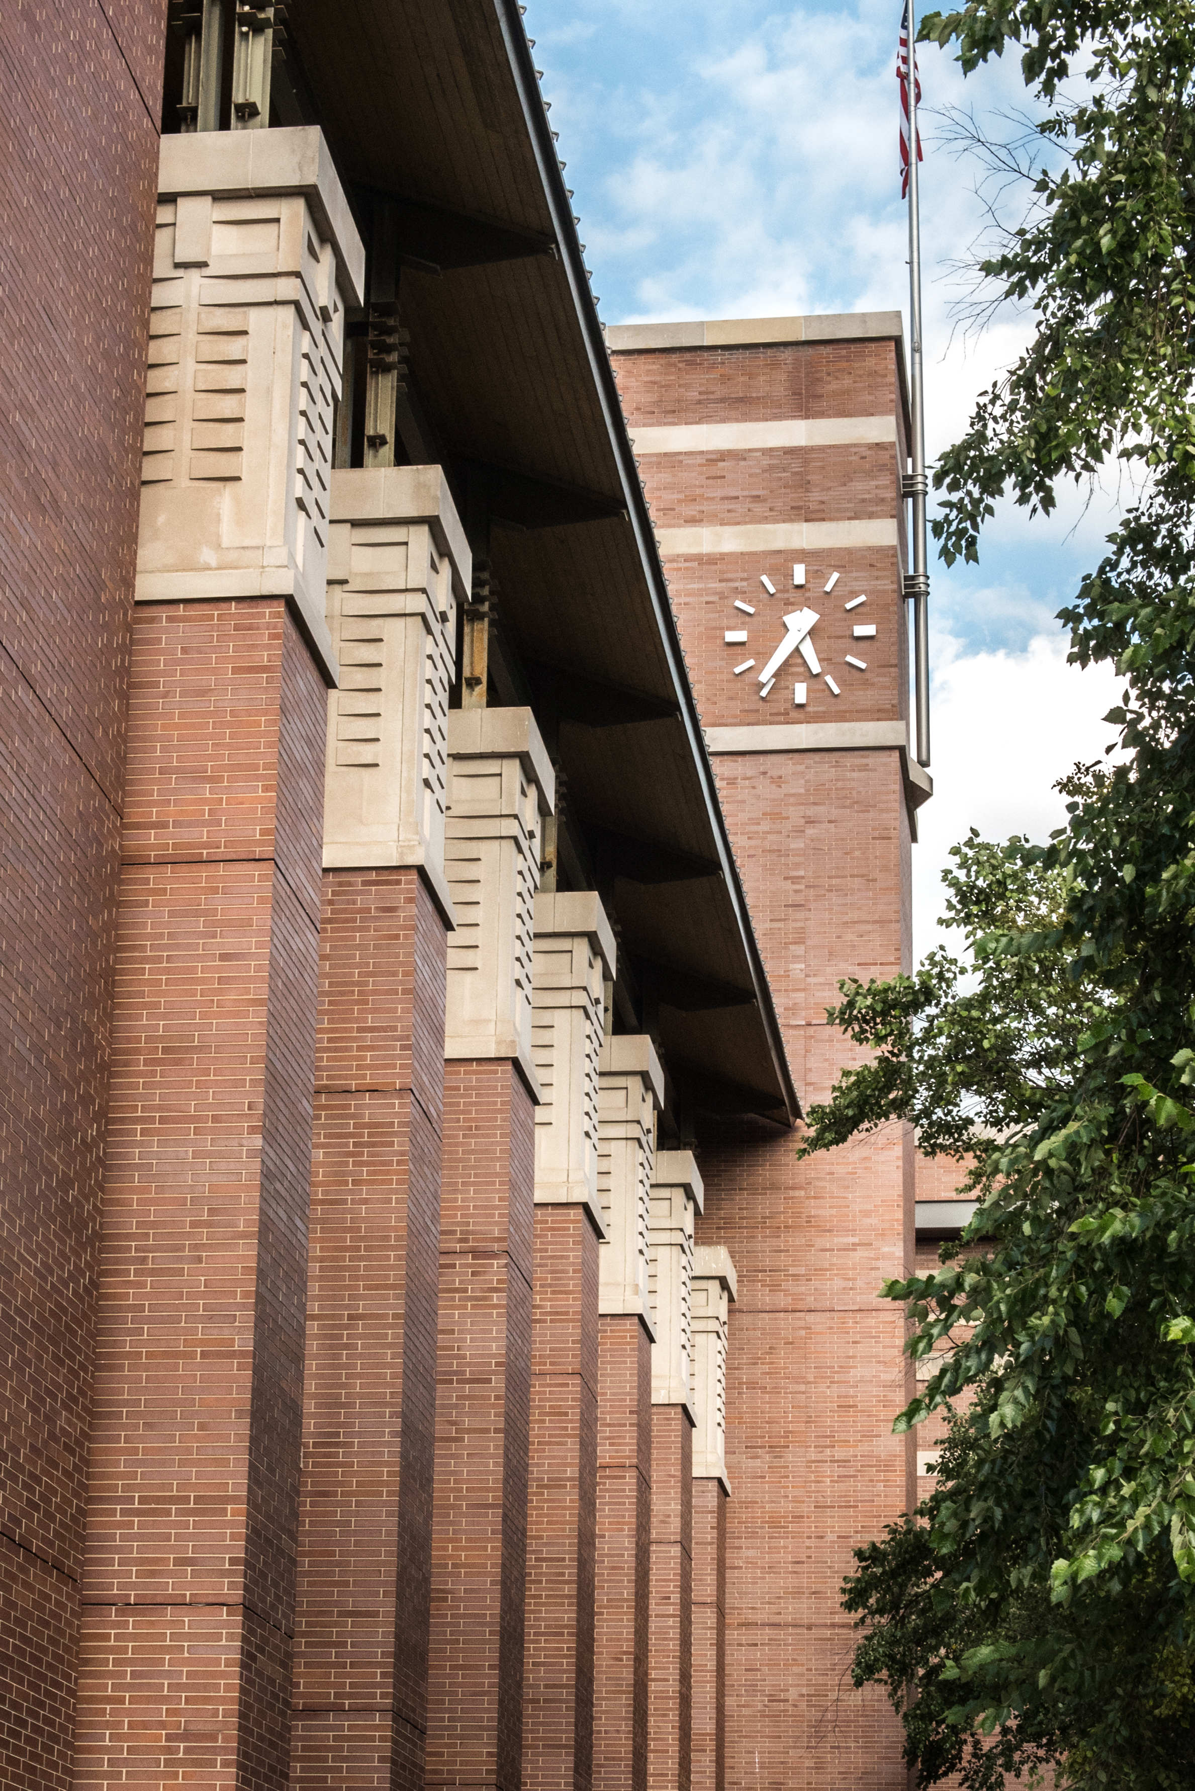
Capital BUDGET REQUEST
Capital Improvement Plan 2020 | Timing
Restroom/Nursing room Remodel | 2021
Area of Rescue Asst/Fire alarm | 2021
Exterior Painting | 2022
Modify Elevator Controls | 2021
Interior Painting | 2021
Landscaping/Architectural Plans | TBD
Capital Improvement Plan 2021
Fire Protection Maintenance | 2021 - 22
HVAC | 2021 - 22
Electrical Upgrades | 2021 - 22
Roof Maintenance | 2021
Entry Door Replacement | 2021
Capital Improvement Plan 2022
Mechanicals - Boilers/Fire System | 2022
Reserve Study Analysis pending
2022 Budget Request

Slide 15
Property tax
EPL receives 3% of total tax paid by Evanston property owners.
Property tax is on track with 55% overall collected. Second installment bills mailed in August, due in October.
2022 Budget Request

Slide 16
Property tax
2022 Property Tax (Option 1)
Property Tax Levy | 2020 | 2021 | 2022
Fund 185 | 7,252,000 | 7,252,000 | 7,402,000
Fund 187 | 0 | 0 | 480,000
TOTAL | 7,252,000 | 7,252,000 | 7,882,000
2022 Budget Request

Slide 17
Property tax
2022 Property Tax (Option 2)
Property Tax Levy | 2020 | 2021 | 2022
Fund 185 | 7,252,000 | 7,252,000 | 7,252,000
Fund 187 | 0 | 0 | 480,000
TOTAL | 7,252,000 | 7,252,000 | 7,732,000
2022 Budget Request

Slide 18
Property tax
Property Tax Bill estimation
Market Value of Property | Assessed Value of Property | Equalized Value of Property | 2019 EPL Tax | 2021 Estimate | 2022 Estimate
100,000 | 10,000 | 29,100 | 74 | 80 | 82
200,000 | 20,000 | 58,200 | 148 | 161 | 164
400,000 | 40,000 | 116,400 | 296 | 322 | 329
600,000 | 60,000 | 177,660 | 451 | 491 | 502
800,000 | 80,000 | 232,800 | 591 | 644 | 657
1,000,000 | 100,000 | 291,000 | 739 | 805 | 822
5,000,000 | 500,000 | 1,455,000 | 3,696 | 4,025 | 4,109
2022 Budget Request

Slide 19
State of Illinois budget impact
Annual Per Capita Grant from State had averaged $90K until 2015 when grant was cut to $57K
2017 grant was not received in 2017
Received $57K grant for 2017 in 2018
Received $97K grant for 2018 in 2018
Received $93K grant for 2019 in 2019
Received $93K grant for 2020
Received $110K grant for 2021 as result of updated Per Capita calculation by State legislature
2022 Budget Request

Slide 20
next steps
September 22 – Library Trustee Meeting for budget discussion
October 18 – COE Proposed Budget Presentation at City Council
October, November – Budget Discussions at City Council, Ward Meetings, Town Hall, etc.
October 20 – Library Truth in Taxation Public Hearing on 2022 Budget and Tax Levy
November 8 – COE Truth in Taxation Public Hearing at City Council
November 18 – Library Trustee Meeting Adoption of tax levy
November 22 – City Council Adoption of budget and tax levies
2022 Budget Request

