Slide 1

Evanston Library Board Meeting
July 17th, 2024

Slide 2

ABOUT US
Our History
  National Able Network was originally founded as Operation ABLE (Ability Based on Long Experience) in 1977. Since then, we’ve been providing workforce services to job seekers of all ages, and have grown our agency’s footprint from serving the Chicagoland area, to now providing workforce services across five states throughout the Midwest:
  Illinois
  Minnesota
  Iowa
  Nebraska
  Indiana
Our FUTURE
  National Able Network guides its mission through the lens of equity, and is leaning into expansion, growth, and continuing to lead from the front of the workforce ecosystem.

Slide 3
ABOUT US
Our IMPACT
  At National Able Network, our mission is to help make careers happen. Each client receives personalized career supports that integrate career coaching, specialized training, and direct connections to the job market.
  Clients received 19% average increase in annual wages
  85% launch new careers with workforce services
  75,000 job seekers served each year
  1,500 mature workers served in 5 states each year
  400 military veterans receive civilian career training each year
  For every $1 contributed, $5.95 is put back into the local economy

Slide 4
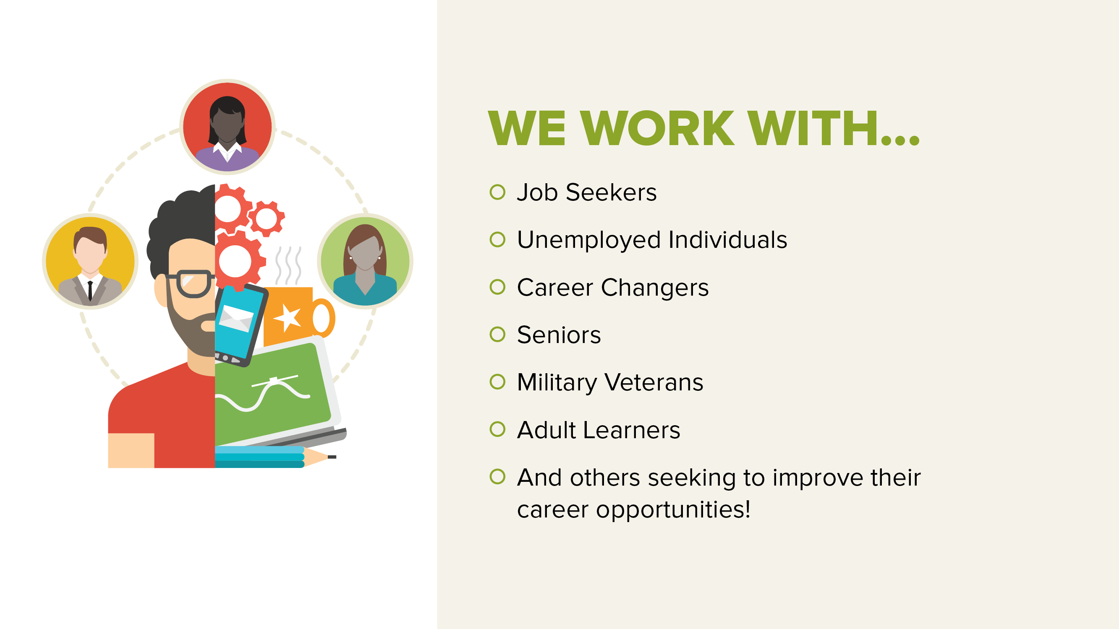

Slide 5
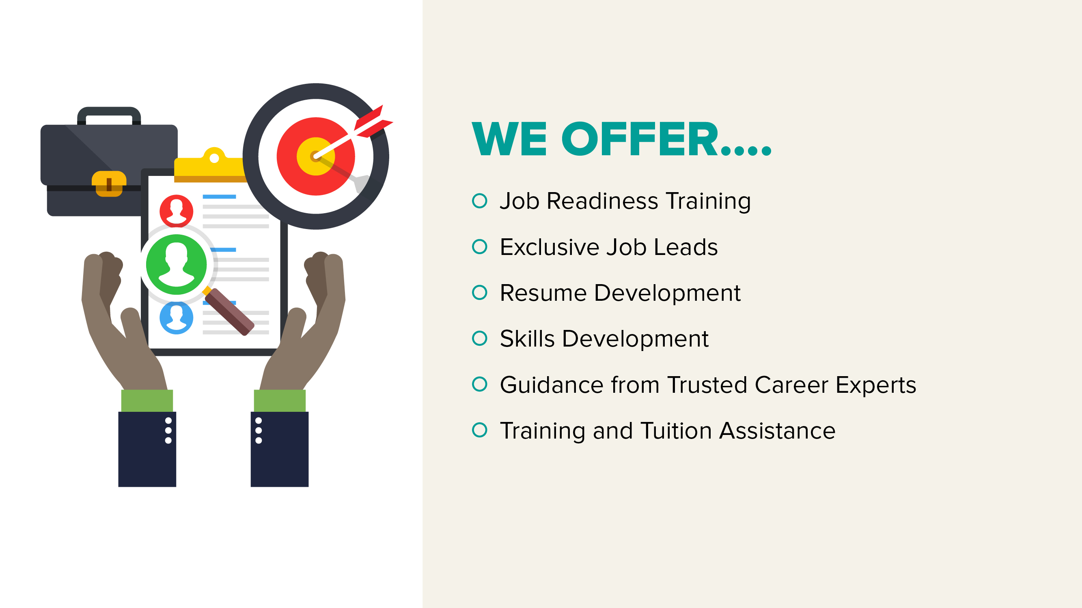

Slide 6

WORKFORCE PROGRAMS
OVERVIEW
  National Able Network offers a variety of workforce programs and services. Programs include the administration of public workforce development programs as well as privately-supported programs that were developed by our expert team.
  Major programs include:
  Workforce Innovation and Opportunity Act
  Senior community service employment program
  Snap e&T STATE intermediary
  It career lab
  National Back Office cooperative

Slide 7






WORKFORCE INNOVATION AND OPPORTUNITY ACT
The Workforce Innovation and Opportunity Act serves the needs of businesses and job seekers and supports a network of American Job Centers across the country. Approximately 20 million Americans in need receive assistance through the program each year.
  National Able Network has operated WIOA programming for decades, helping thousands of businesses connect with talented job seekers and bringing together community stakeholders in high-performing American Job Centers across the Midwest each year.
  Each year, National Able Network serves approximately 50,000 job seekers and businesses through Workforce Innovation and Opportunity Act programming across all our locations.
  Local funding is provided through the Chicago Cook Workforce Partnership for the services we provide at the Library.

Slide 8
EVANSTON PARTNERSHIP AND IMPACT
  We have been a co-located partner with the Evanston Public Library for over a decade and view our relationship as critical to ensuring individuals within the community can access workforce and job seeking employment assistance in addition to the myriad of services the Library provides.
  We value our partnership with the Library and are looking forward to a bright future of continued collaboration.

Slide 9
EVANSTON PARTNERSHIP AND IMPACT
Our IMPACT
  Over the last full contract year (10/1/2022 – 9/30/2023) we provided area job seekers with the following assistance at our office within the Library:
  134 individuals received employment or job search services
  91 were enrolled in WIOA programming
  32 received credentials from vocational training
  63 job seekers were placed into full time employment
  In addition to serving job seekers, we also assist the business community by hosting hiring events, job fairs, providing resources to offset the cost of training/hiring new talent, and job matching candidates to great jobs.
  We served 72 area employers throughout the last contract year
  Coordinated/participated in 15 area job fairs/hiring events including our Workforce Wednesday events

Slide 10

EVANSTON PARTNERSHIP AND IMPACT
  The current contract year (10/1/2023 – 9/30/2024) has seen a substantial uptick in the need for our services from the previous year:
  205 individuals have received employment or job search services
  99 were enrolled in WIOA programming
  40 received credentials from vocational training
  48 job seekers placed into full time employment
  76 employers served
  8 hiring events/job fairs held in the area including the Hospitality Hires North event held in May at the Hilton Orrington in partnership with several area, county and State partners
    This event had over 120 job seekers attend, with multiple employment offers being issued on the spot

Slide 11
Thank you!

