Slide 1

Financial Report June 2024

Slide 2
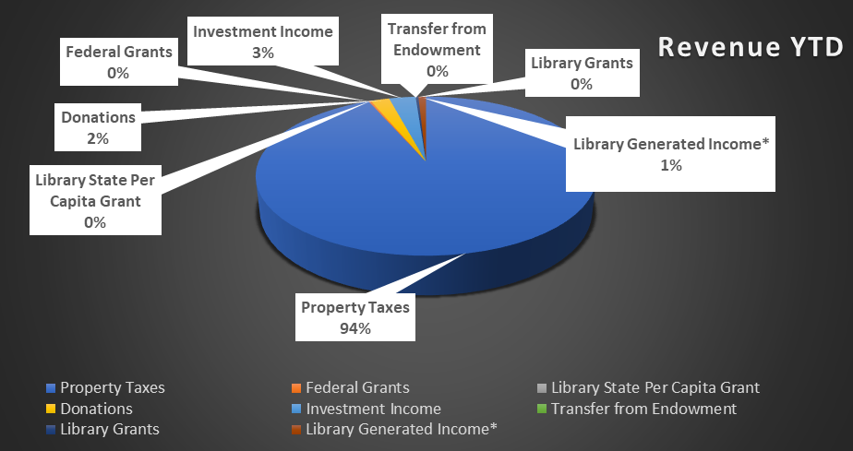
Revenue

Slide 3
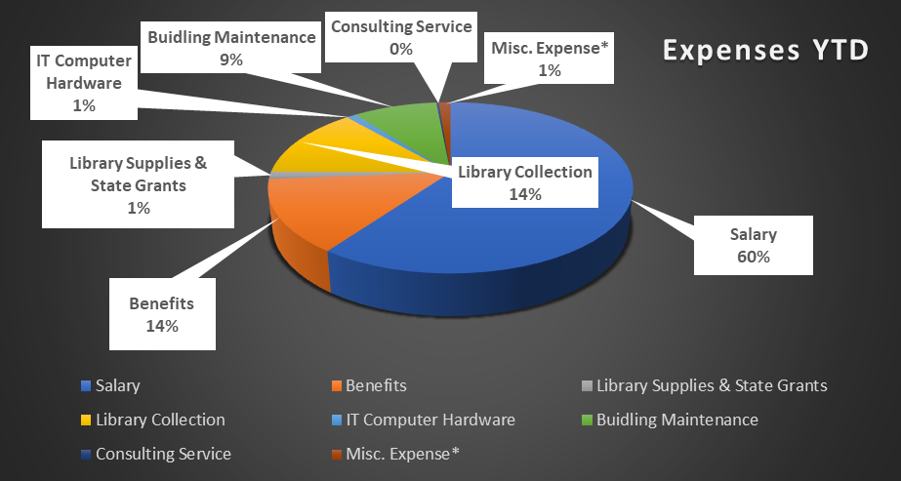
Expense

Slide 4
Month-Wise Report

Slide 5
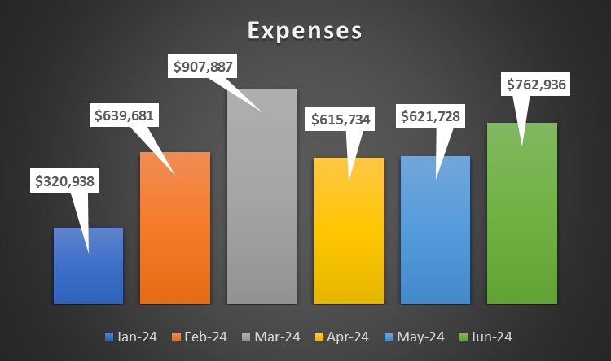
Month-Wise Report

Slide 6
Fund 186 – Library Debt Service

Slide 7
Fund 187 – Library Capital Improvement Fund

